Slide 1

How does Selenium Find Elements?
Maciej Wyrodek

Slide 2


About Me
Community leader and test automation expert at Objectivity
Blog: https://thebrokentest.com
ChainAnallyzer: https://www.nuget.org/packages/ChainAnalyzer

Slide 3
How does Selenium Find Elements?
Maciej Wyrodek

Slide 4

You don’t have to be an engineer to be a racing driver, but you do have to have Mechanical Sympathy.
- Jackie Stewart

Slide 5


A Long Time Ago…
Let's keep locators as Xpath!
I see a lot of issues with this approach:
Xpath is the simplest and allows for most of the things. Besides, it all treated the same by the browser!
This Photo by Unknown Author is licensed under CC BY-NC-ND

Slide 6
How I was taught
ID
Name
Css
Xpath
Link text

Slide 7

Let’s code

Slide 8
A Long Time Ago… But not as long as previously.
This experiment is not valid, it doesn’t reflect real-world scenario, and there are too many variables that could affect the result!
This Photo by Unknown Author is licensed under CC BY-NC-ND

Slide 9


Slide 10

Postman

Slide 11
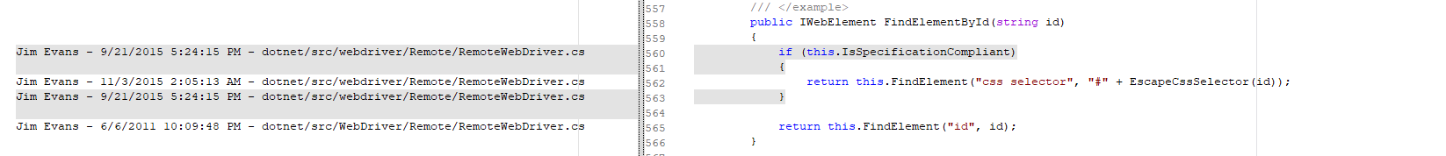

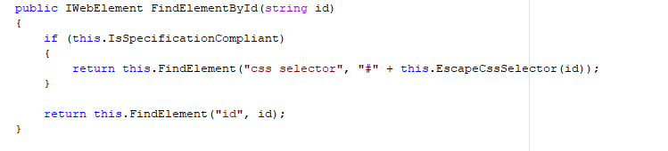
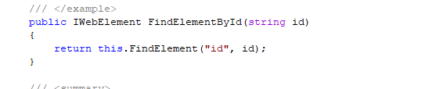
Let’s Go To code
2011-2015
2015-NOW

Slide 12
A Long Time Ago…
Ok! I give up you are right!
This Photo by Unknown Author is licensed under CC BY-NC-ND

Slide 13

Let’s look INTO ChromeDriver COde

Slide 14

Time For Theory

Slide 15
2004 – Jason Huggins Creates Selenium
Later known as Selenium Core

Slide 16
„Selenium tool started as a developers tool, for developers by developers.”
Jason Huggins

Slide 17



Selenium is used To Cure Mercury Poisoning

Slide 18

Selenium is used To Cure Mercury Poisoning

Slide 19
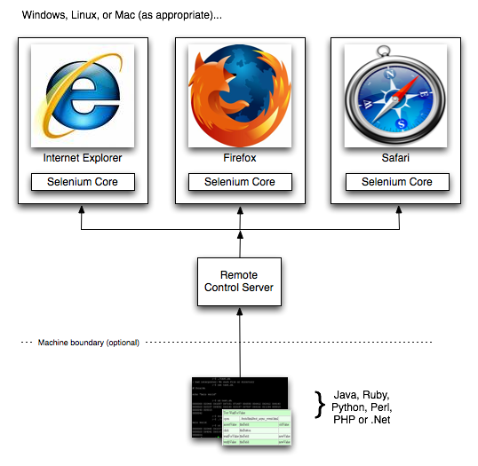
Old Times Selenium RC
Notes:
Source: https://www.seleniumhq.org/projects/remote-control/

Slide 20
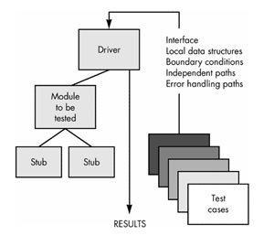
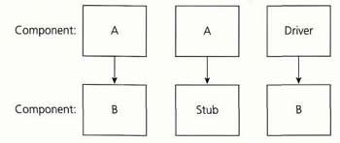
2006 – SImon StewaRT Start Work on Web Driver

Slide 21
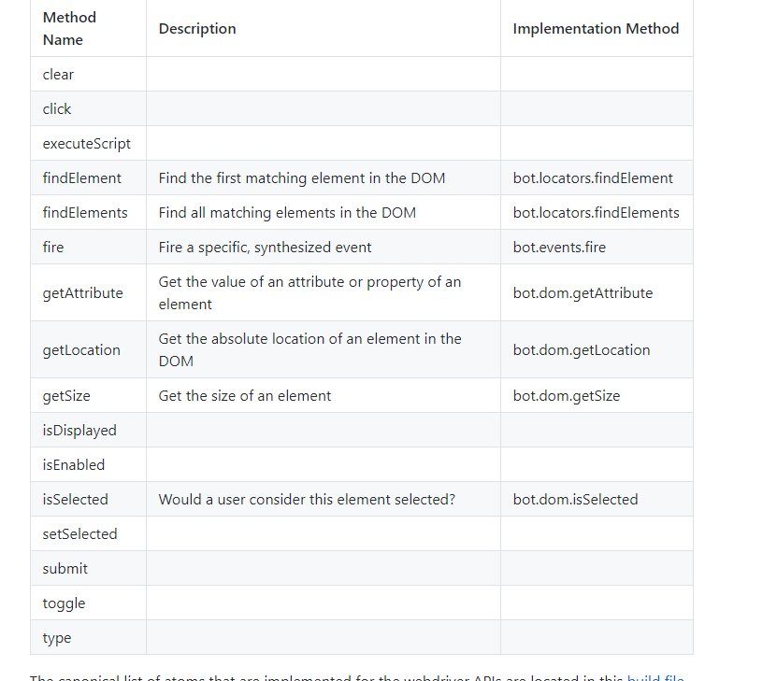
Automation Atoms

Slide 22


Slide 23
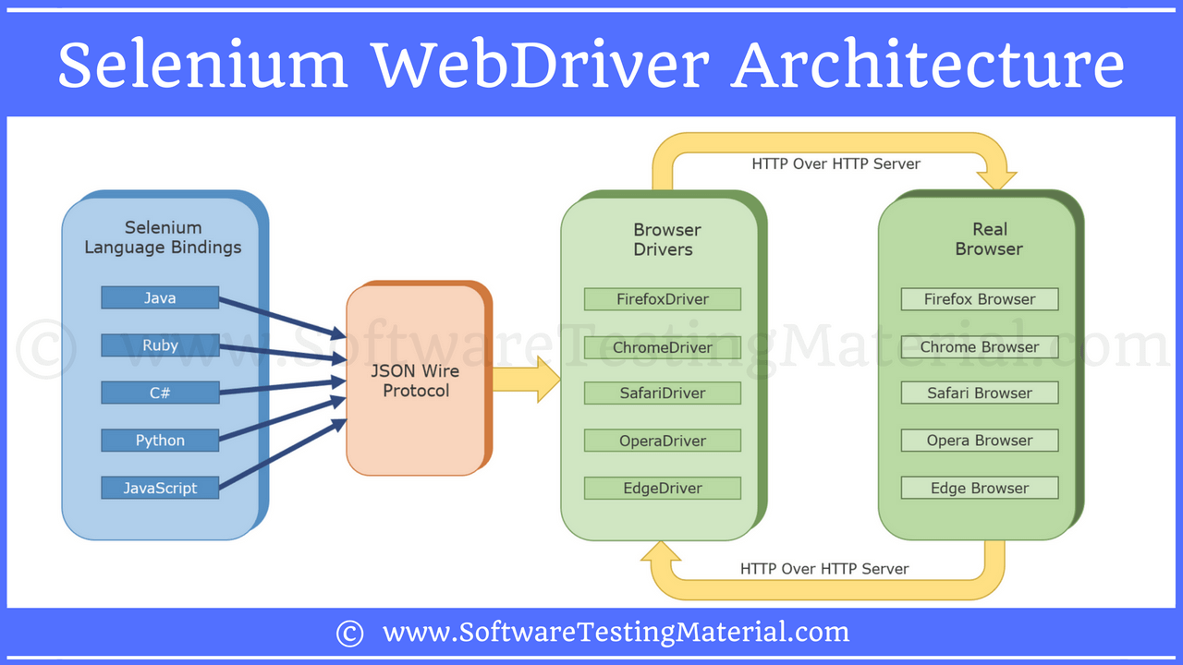
Selenium 2.0

Slide 24
Selenium doesn't find elements
It asks the browser to fetch element with the given locator.

Slide 25

But how does it happens?

Slide 26

Let’s look at some documentation
Notes:
Wrzucic jakiegoś znudzonego gościa w tło

Slide 27
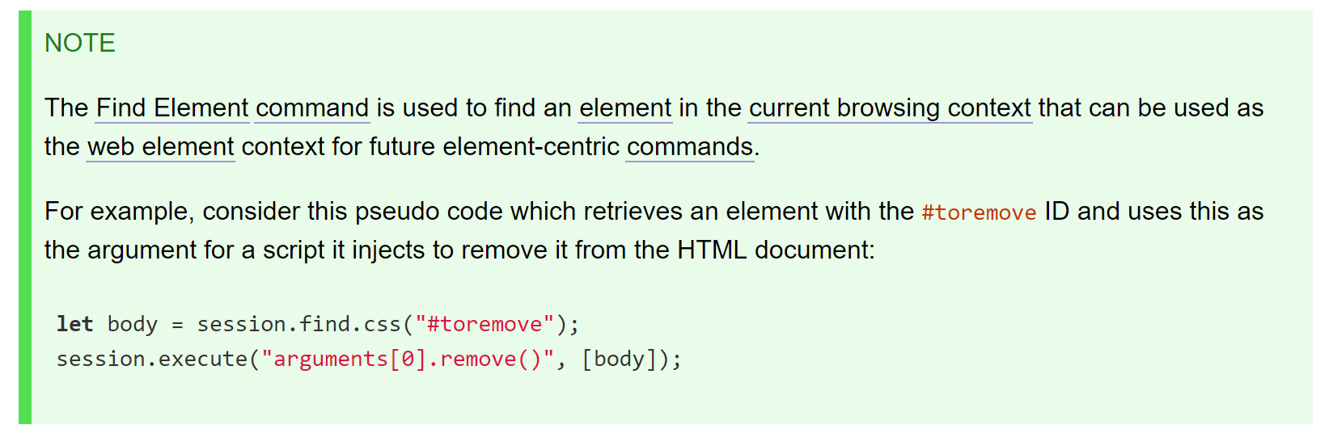

Slide 28
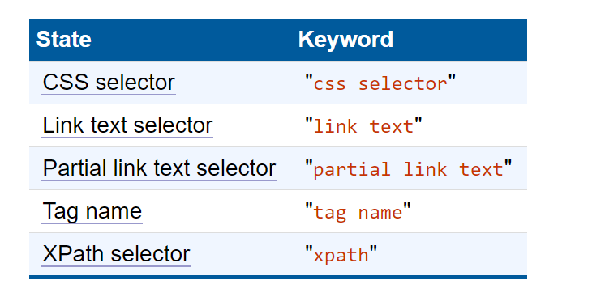
Locator StRategies

Slide 29
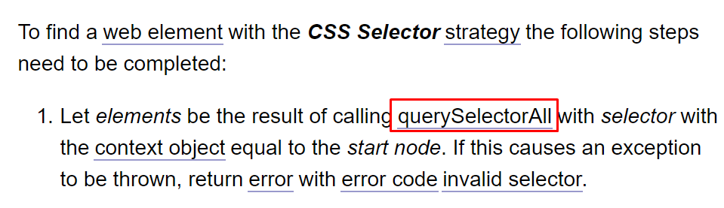
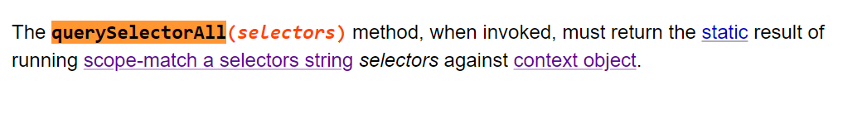
CSS Selector

Slide 30
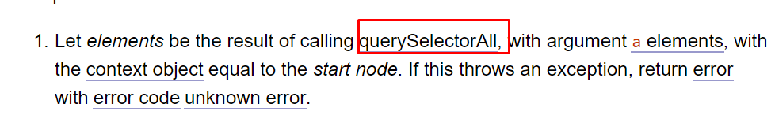
Link Text & Partial link tex

Slide 31
Locator Strategies
STATE | KEYWORD | DOM call | DOM LEVEL
CSS selector | css selector | querySelectorAll | 2
Link text selector | link text | querySelectorAll | 2
Partial link text selector | partial link text | querySelectorAll | 2
Tag name | tag name | getElementByTagName | 2
XPath selector | xpath | Evaluate ORDERED_NODE_SNAPSHOT_TYPE | 3

Slide 32
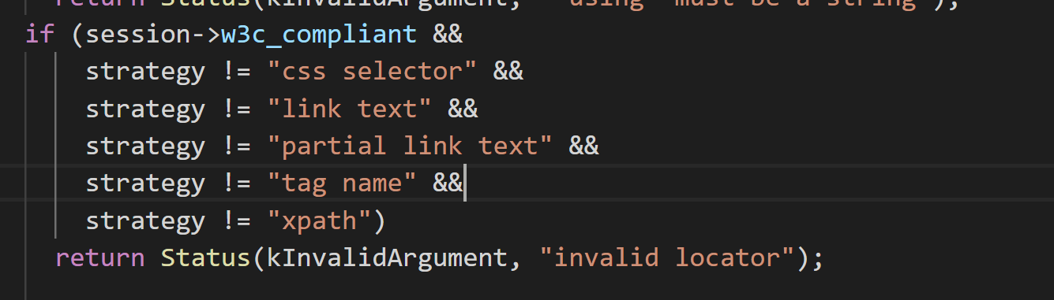
Notes:
https://github.com/bayandin/chromedriver
Element_utill.cc 300

Slide 33
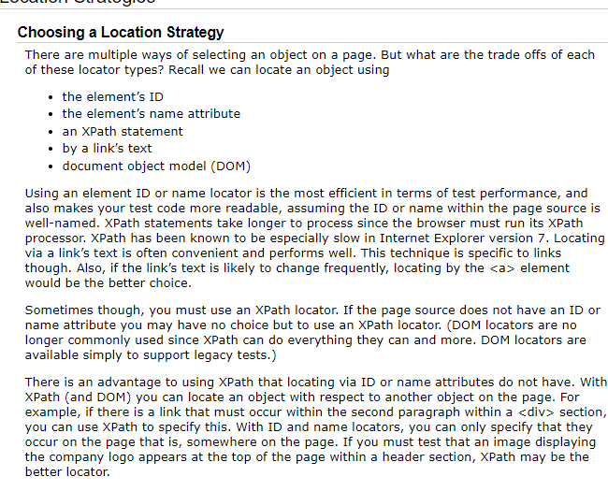
How I was taught
ID
Name
Css
Xpath
Link text
Notes:
https://www.seleniumhq.org/docs/06_test_design_considerations.jsp#location-strategies

Slide 34
Selenium 2.0

Slide 35
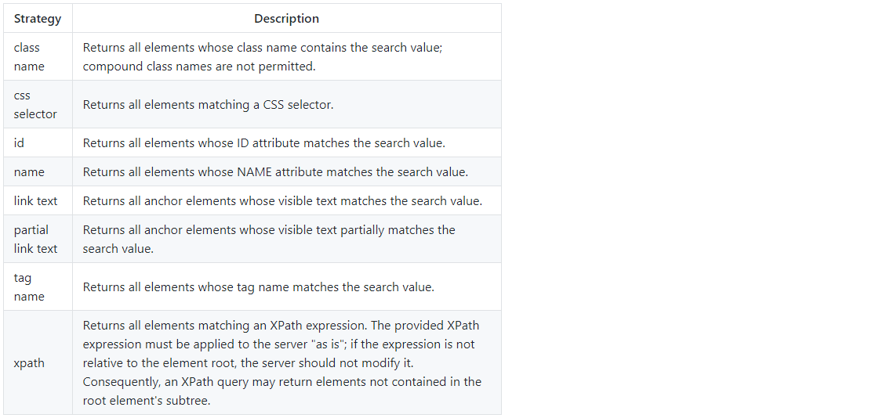
Notes:
https://stackoverflow.com/questions/48369043/official-locator-strategies-for-the-webdriver
https://github.com/w3c/webdriver/issues/1042

Slide 36
Selenium 2.0
WEBDRVIVER
WIRE
PROTOCOL

Slide 37


Okay How does it work?
Chrome DevTools Protocol
Marionette

Slide 38
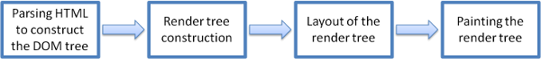

Slide 39
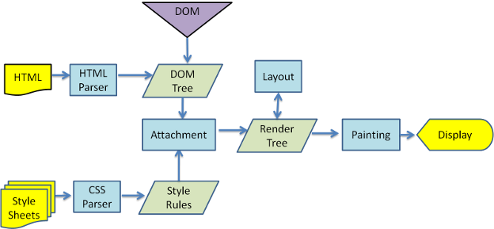
wEBKIT MAIN FLOW

Slide 40
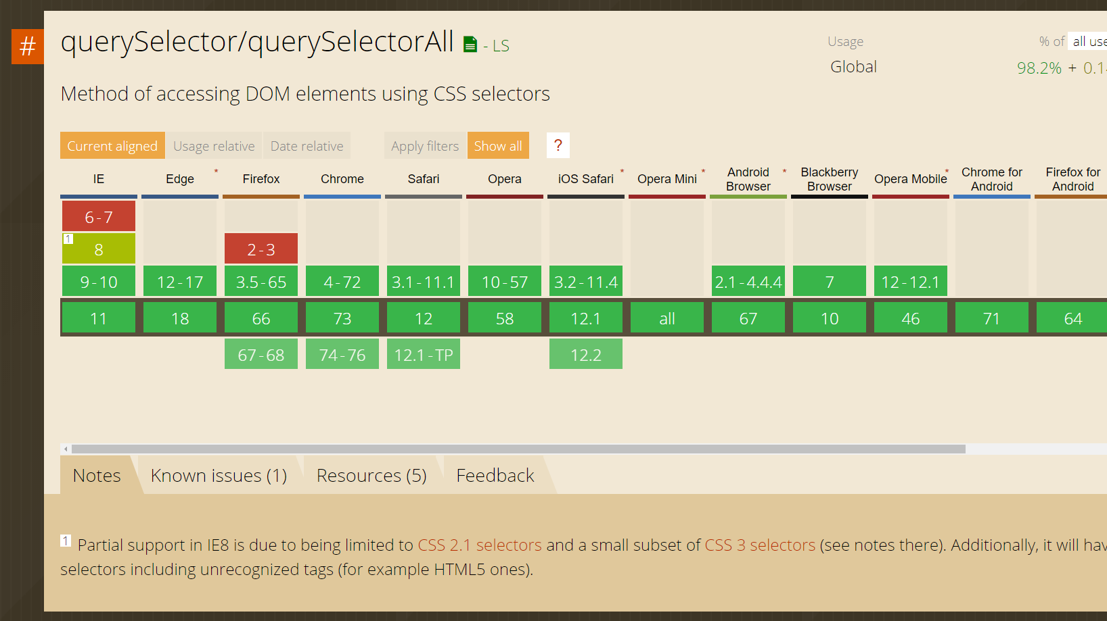
Notes:
https://caniuse.com/#search=qu

Slide 41
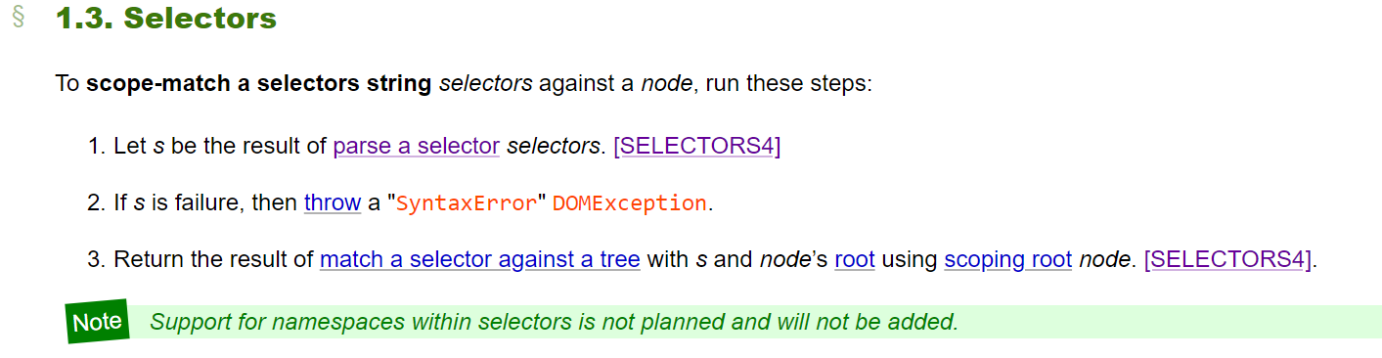
QuerySelectorAll
Notes:
https://dom.spec.whatwg.org/#selectors

Slide 42
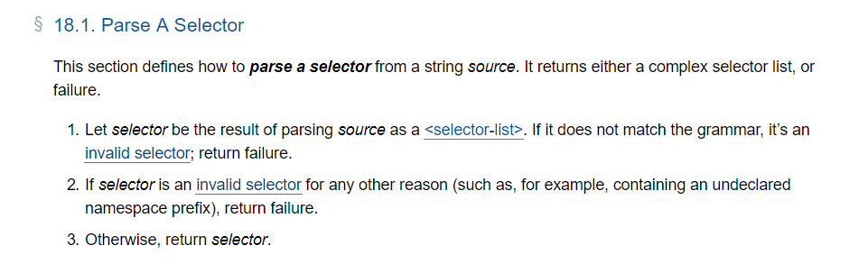
Notes:
https://drafts.csswg.org/selectors-4/#match-a-selector-against-a-tree

Slide 43
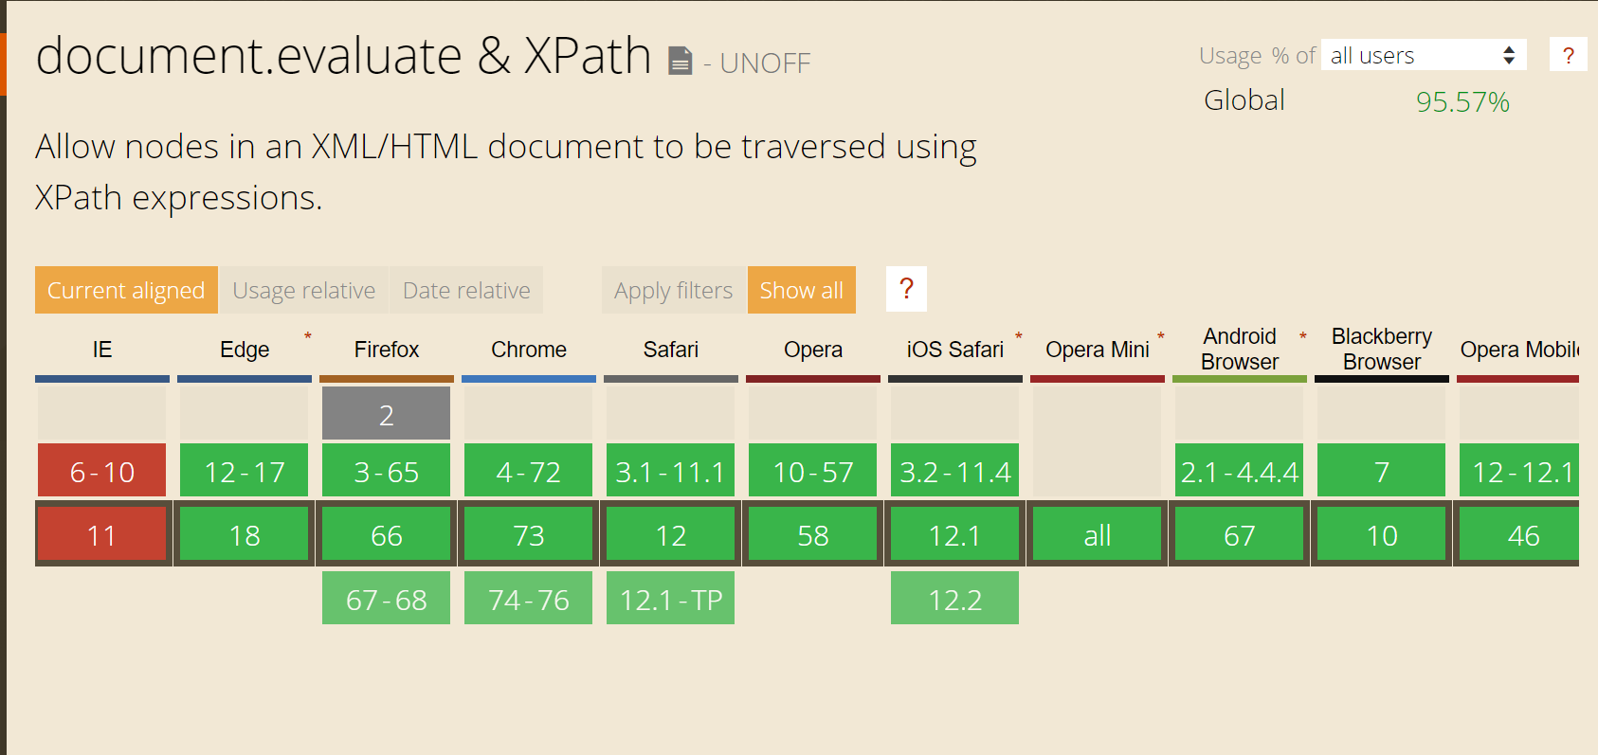
Xpath

Slide 44
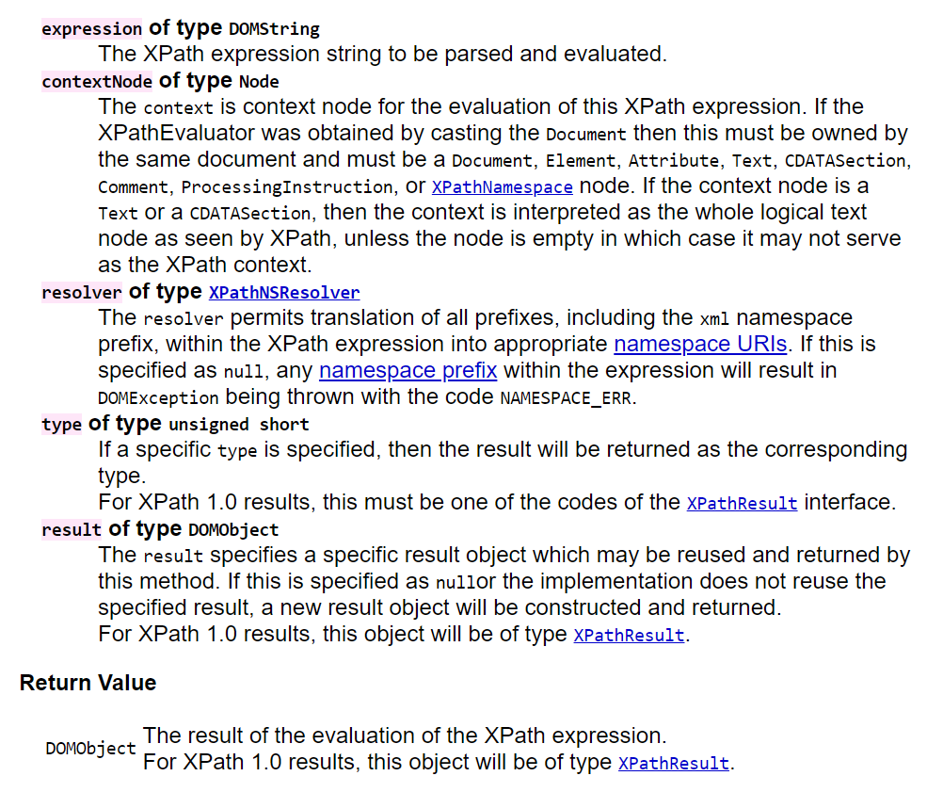
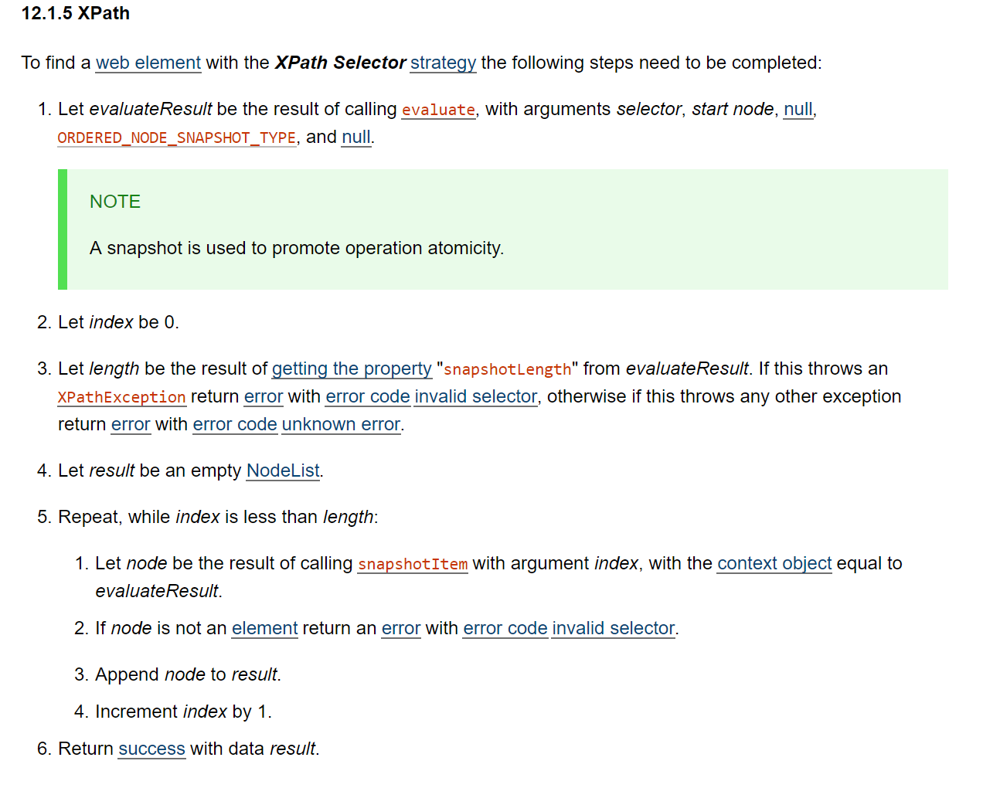
XPATH

Slide 45

Let's measure performance one more time!
(but in a less awkward way)
Notes:
https://jsperf.com/queryselectorall-vs-getelementsbytagname/179

Slide 46
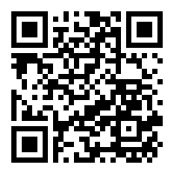
To Sum it up
He Was wrong but know he is Right (sort of)
Selenium doesn't find elements it asks for it!
After all the men in the middle it is basicly served by Dom

Slide 47
Sources
Test Doubles:
https://www.martinfowler.com/bliki/TestDouble.html
http://www.differencebetween.info/difference-between-stub-and-driver
Documentations & Standards
https://dom.spec.whatwg.org/
https://www.w3.org/TR/DOM-Level-3-XPath/
https://www.w3.org/TR/selectors-api/
https://www.w3.org/TR/webdriver1/

Slide 48
Sources pt 2
Code Repositories
https://github.com/SeleniumHQ/selenium
https://chromium.googlesource.com/chromium/src/+/master/chrome/test/chromedriver/
https://github.com/bayandin/chromedriver
https://github.com/ChromeDevTools/awesome-chrome-devtools
Other
http://scraping.pro/what-is-selenium-webdriver/
https://github.com/SeleniumHQ/selenium/wiki/Automation-Atoms
https://caniuse.com
https://firefox-source-docs.mozilla.org/testing/marionette/Intro.html
https://chromedevtools.github.io/devtools-protocol/

Slide 49
Sources pt 3
Podcasts & Videos:
https://www.youtube.com/watch?v=Vlz-WmcrBL8
https://www.angryweasel.com/ABTesting/ab-testing-episode-103-the-croissants-are-selenium-with-jason-huggins/
https://www.ministryoftesting.com/dojo/lessons/the-use-and-abuse-of-selenium-simon-stewart
https://www.youtube.com/watch?v=NtEZ2aBszrc
Other & Videos
https://stackoverflow.com/questions/48369043/official-locator-strategies-for-the-webdriver
https://www.youtube.com/watch?v=NtEZ2aBszrc
https://seleniumhq.github.io/docs/site/en/
https://www.youtube.com/watch?v=IcCnzXTxFt0

Slide 50
Sources pt 4
Other:
https://cs.chromium.org/chromium/src/chrome/test/chromedriver/README.txt
https://www.html5rocks.com/en/tutorials/internals/howbrowserswork/
https://wiki.mozilla.org/Gecko:Overview
https://html.spec.whatwg.org/multipage/parsing.html
Other:
https://docs.google.com/spreadsheets/d/1r0hCQ_PGyS0upupU5cOqTnRpHSGKq-I_zHdjCrN446Y/edit?usp=sharing
https://jsperf.com/queryselectorall-vs-getelementsbytagname/179

